Slide 1

10 Productivity Tools in 20 Minutes
John Morehouse Rob sewell

Slide 2

Contestants
John
Rob

Slide 3

Photo by Ricardas Brogys on Unsplash
Notes:
You can see that our beards are grey. So we are old. We are both consultants, working with various clients. We both love automation.
These are some of the tools that we use to make our lives easier.
If you wish to skip to the details – you can find them here
Happy with a beard.media link ?

Slide 4
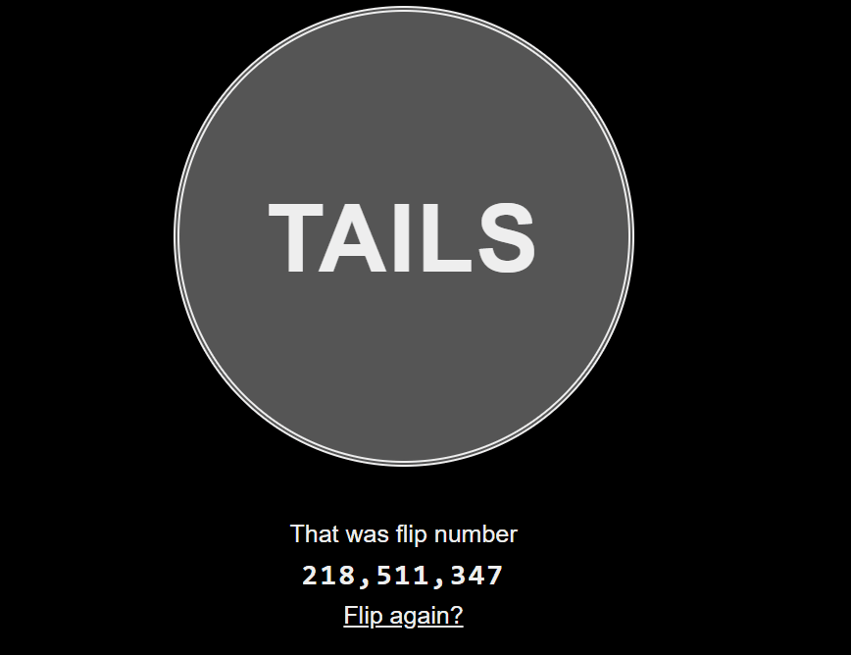
90
80
70
60
50
40
30
20
10
ScreenToGif
Notes:
John
(this is a great example)
Love it – tell the story and describe the use case ?

Slide 5

90
80
70
60
50
40
30
20
10
Notes:
Rob
Homebrew for mac

Slide 6
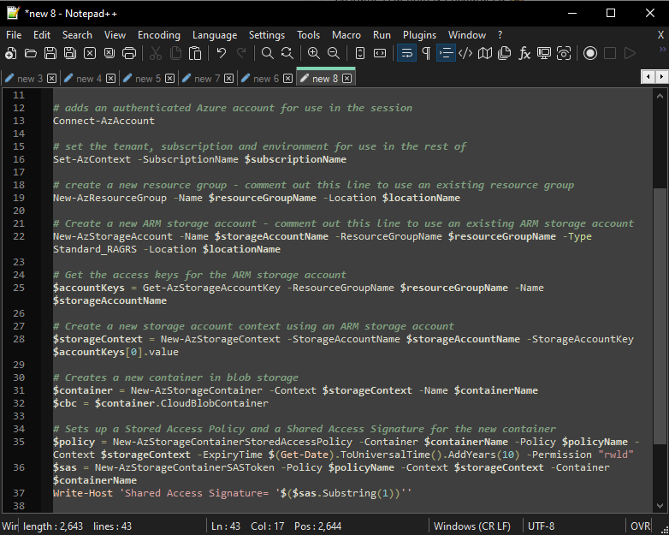
90
80
70
60
50
40
30
20
10
Notepad++
Notes:
John
File editing
XML plugins
Macros
Multi-line editing capabilities
Syntax color coding

Slide 7
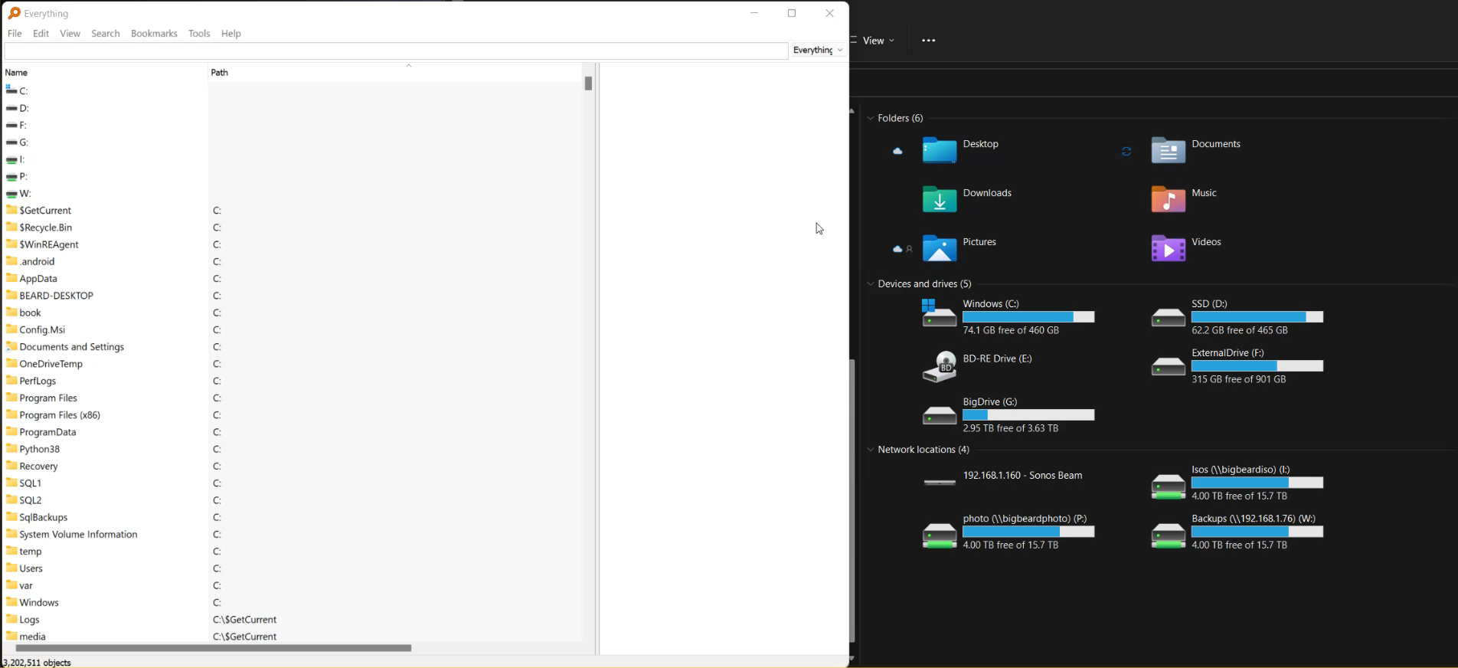
90
80
70
60
50
40
30
20
10
Everything
Notes:
Rob
Search on Windows is slow. I use Everything from void tools to search everything on my machine and my mapped drives from my NAS. Everything is super blazing frightenly quick. It does it by using the underlying NTFS Master File Table. It has a really small memory footprint and PowerShell functions. Makes finding files realy quick and simple (unlike Windows .....)
How is Everything different from other search engines
Small installation file.
Clean and simple user interface.
Quick file indexing.
Quick searching.
Quick startup.
Minimal resource usage.
Small database on disk.
Real-time updating.

Slide 8
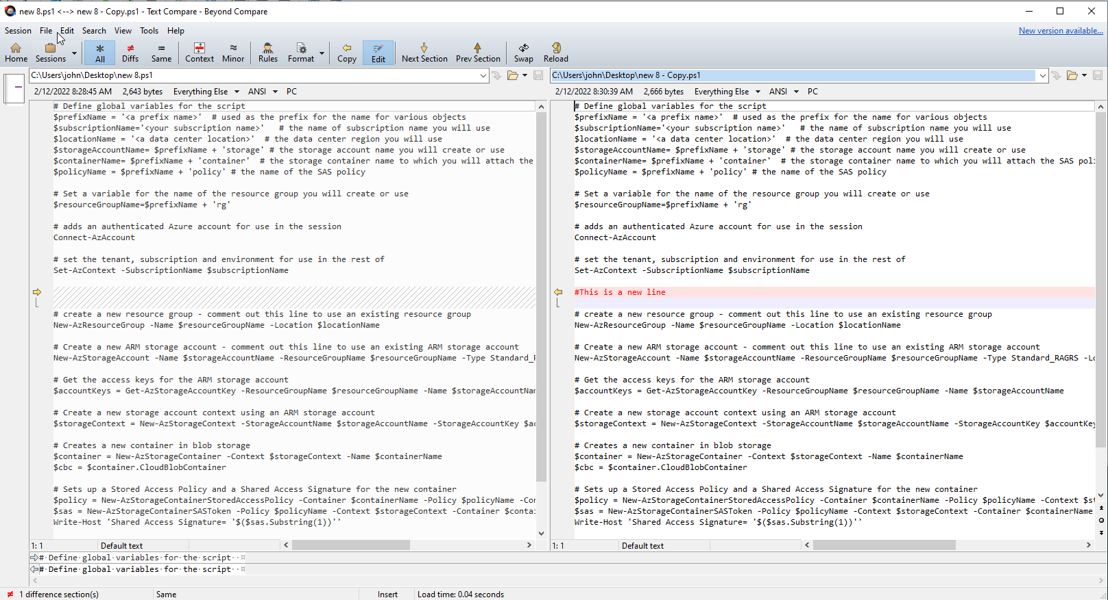
90
80
70
60
50
40
30
20
10
Beyond Compare
Notes:
John
$60 for standard license
Compare text files
Compare folder contents
Easily identify differences

Slide 9
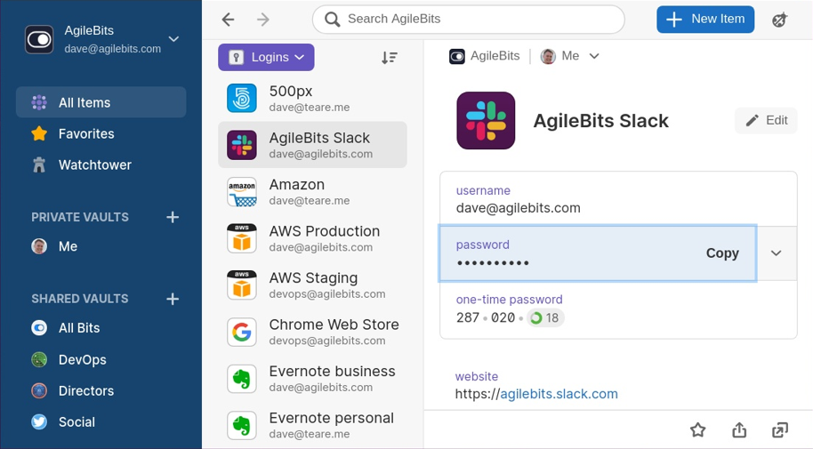
90
80
70
60
50
40
30
20
10
1Password
Notes:
John
WatchTower
HIBP’d
International Traveler
Shared Vaults
Family Plans (see shared vaults)
Image source: https://frunction.com/2020/08/1password-linux-development-beta/ licensed under https://creativecommons.org/licenses/by-nc-sa/4.0/

Slide 10
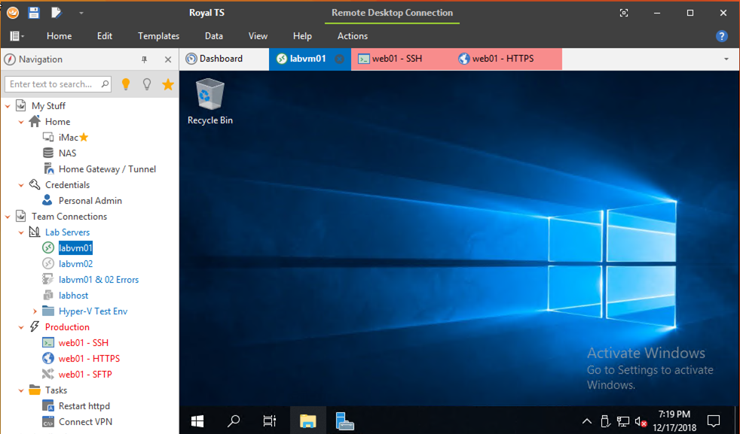
90
80
70
60
50
40
30
20
10
RoyalTS
Notes:
John
Folders
RDP into stuff (client folder structure)
SSH ability
Credentials storage
Syncable (IE dropbox/onedrive)

Slide 11
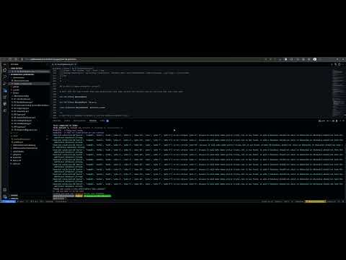
90
80
70
60
50
40
30
20
10
https://youtu.be/cvFnvXhKg78
Notes:
Rob - Github

Slide 12
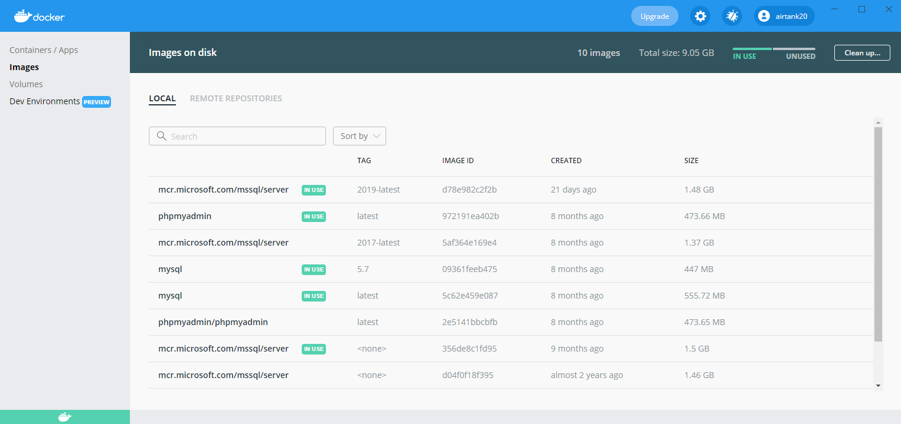
90
80
70
60
50
40
30
20
10
Docker
Notes:
John
Easily standup environments locally
Quick SQL box

Slide 13
90
80
70
60
50
40
30
20
10
Visual Studio Code
Insert screen shot of it doing a load of things which can run whilst I talk
Notes:
Rob
VS Code, does so much – all the languages, all the comparing, docker, bicep, dev containers, source control

Slide 14

Feedback Please. Good or Bad Just tell us why

Slide 15




Slide 16
90
80
70
60
50
40
30
20
10
Countdown main – mess with it here and copy pasta

